Slide 1
Hash functions

Slide 2
Outline
In this talk, we will discuss
Finding 32-bit hash values using:
Predetermined hash values
Auto-incremented hash values
Address-based hash values
Arithmetic hash values
Example: strings

Slide 3
Definitions
9.2
What is a hash of an object?
From Merriam-Webster:
a restatement of something that is already known
The ultimate goal is to map onto an integer range 0, 1, 2, ..., M – 1

Slide 4
The hash process
9.2.1
Object
We will look at the first problem
Hashing an object into a 32-bit integer
Subsequent topics will examine the next steps
32-bit integer
Modulus, mid-square, multiplicative, Fibonacci
Map to an index 0, ..., M – 1
Deal with collisions
Chained hash tables
Open addressing
Linear probing
Quadratic probing
Double hashing

Slide 5
Properties
9.2.2
Necessary properties of such a hash function h are:
1a. Should be fast: ideally Θ(1)
1b. The hash value must be deterministic
It must always return the same 32-bit integer each time
1c. Equal objects hash to equal values
x = y ⇒ h(x) = h(y)
1d. If two objects are randomly chosen, there should be only a one-in- 2³² chance that they have the same hash value

Slide 6
Types of hash functions
9.2.3
We will look at two classes of hash functions
Predetermined hash functions (explicit)
Arithmetic hash functions (implicit)

Slide 7
Predetermined hash functions
9.2.4
The easiest solution is to give each object a unique number
class Class_name {
private:
unsigned int hash_value; // int: –2³¹, ..., 2³¹ – 1
// unsigned int: 0, ..., 2³² – 1
public:
Class_name();
unsigned int hash() const;
};
Class_name::Class_name() {
hash_value = ???;
}
unsigned int Class_name::hash() const {
return hash_value;
}

Slide 8
Predetermined hash functions
9.2.4
For example, an auto-incremented static member variable
class Class_name {
private:
unsigned int hash_value;
static unsigned int hash_count;
public:
Class_name();
unsigned int hash() const;
};
unsigned int Class_name::hash_count = 0;
Class_name::Class_name() {
hash_value = hash_count;
++hash_count;
}
unsigned int Class_name::hash() const {
return hash_value;
}

Slide 9
Predetermined hash functions
9.2.4
Examples: All UW co-op student have two hash values:
UW Student ID Number
Social Insurance Number
Any 9-digit-decimal integer yields a 32-bit integer
lg( 10⁹ ) = 29.897

Slide 10
Predetermined hash functions
9.2.4
If we only need the hash value while the object exists in memory, use the address:
unsigned int Class_name::hash() const {
return reinterpret_cast<unsigned int>( this );
}
This fails if an object may be stored in secondary memory
It will have a different address the next time it is loaded

Slide 11
Predetermined hash functions
9.2.4.1
Predetermined hash values give each object a unique hash value
This is not always appropriate:
Objects which are conceptually equal:
Rational x(1, 2);
Rational y(3, 6);
Strings with the same characters:
string str1 = "Hello world!";
string str2 = "Hello world!";
These hash values must depend on the member variables
Usually this uses arithmetic functions

Slide 12
Arithmetic Hash Values
9.2.5
An arithmetic hash value is a deterministic function that is calculated from the relevant member variables of an object
We will look at arithmetic hash functions for:
Rational numbers, and
Strings

Slide 13
Rational number class
9.2.5.1
What if we just add the numerator and denominator?
class Rational {
private:
int numer, denom;
public:
Rational( int, int );
};
unsigned int Rational::hash() const {
return static_cast<unsigned int>( numer ) +
static_cast<unsigned int>( denom );
}

Slide 14
Rational number class
9.2.5.1
We could improve on this: multiply the denominator by a large prime:
class Rational {
private:
int numer, denom;
public:
Rational( int, int );
};
unsigned int Rational::hash() const {
return static_cast<unsigned int>( numer ) +
429496751*static_cast<unsigned int>( denom );
}

Slide 15
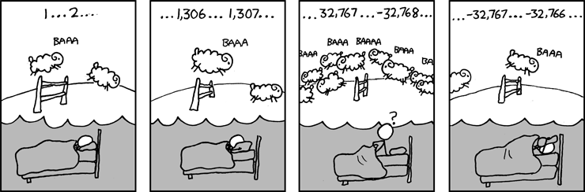
Rational number class
9.2.5.1
For example, the output of
int main() {
cout << Rational( 0, 1 ).hash() << endl;
cout << Rational( 1, 2 ).hash() << endl;
cout << Rational( 2, 3 ).hash() << endl;
cout << Rational( 99, 100 ).hash() << endl;
return 0;
}
is
429496751
858993503
1288490255
2239
Recall that arithmetic operations wrap on overflow
http://xkcd.com/571/

Slide 16
Rational number class
9.2.5.1
This hash function does not generate unique values
The following pairs have the same hash values:
0/1 1327433019/800977868
1/2 534326814/1480277007
2/3 820039962/1486995867
Finding rational numbers with matching hash values is very difficult:
Finding these required the generation of 1 500 000 000 random rational numbers
It is fast: Θ(1)
It does produce an even distribution

Slide 17
Rational number class
9.2.5.1
Problem:
The rational numbers 1/2 and 2/4 have different values
The output of
int main() {
cout << Rational( 1, 2 ).hash();
cout << Rational( 2, 4 ).hash();
return 0;
}
is
858993503
1717987006

Slide 18
Rational number class
9.2.5.1
Solution: divide through by the greatest common divisor
Rational::Rational( int a, int b ):numer(a), denom(b) {
int divisor = gcd( numer, denom );
numer /= divisor;
denom /= divisor;
}
int gcd( int a, int b) {
while( true ) {
if ( a == 0 ) {
return (b >= 0) ? b : -b;
}
b %= a;
if ( b == 0 ) {
return (a >= 0) ? a : -a;
}
a %= b;
}
}

Slide 19
Rational number class
9.2.5.1
Problem:
The rational numbers and have different values
The output of
int main() {
cout << Rational( 1, 2 ).hash();
cout << Rational( -1, -2 ).hash();
return 0;
}
is
858993503
3435973793

Slide 20
Rational number class
9.2.5.1
Solution: define a normal form
Require that the denominator is positive
Rational::Rational( int a, int b ):numer(a), denom(b) {
int divisor = gcd( numer, denom );
divisor = (denom >= 0) ? divisor : -divisor;
numer /= divisor;
denom /= divisor;
}

Slide 21
String class
9.2.5.3
Two strings are equal if all the characters are equal and in the identical order
A string is simply an array of bytes:
Each byte stores a value from 0 to 255
Any hash function must be a function of these bytes

Slide 22
String class
9.2.5.3.1
We could, for example, just add the characters:
unsigned int hash( const string &str ) {
unsigned int hash_vaalue = 0;
for ( int k = 0; k < str.length(); ++k ) {
hash_value += str[k];
}
return hash_value;
}

Slide 23
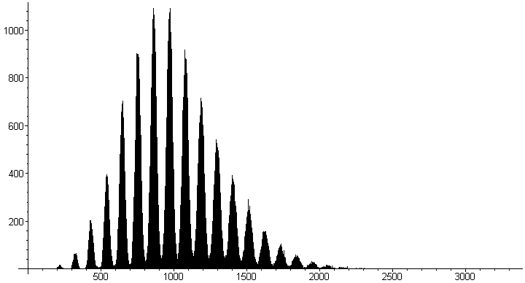
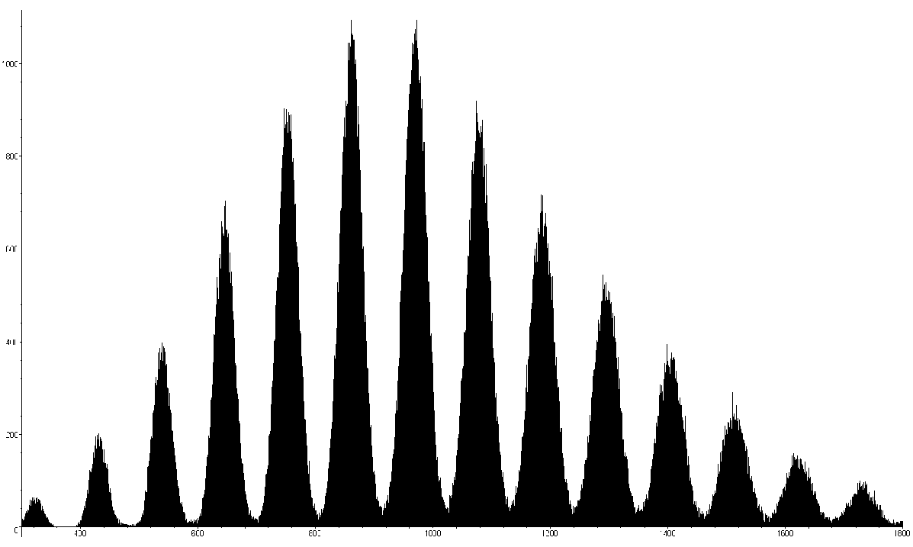
String class
9.2.5.3.1
Not very good:
Slow run time: Θ(n)
Words with the same characters hash to the same code:
"form" and "from"
A poor distribution, e.g., all words in MobyTM Words II by Grady Ward (single.txt) Project Gutenberg):

Slide 24
String class
9.2.5.3.2
Let the individual characters represent the coefficients of a polynomial in x:
p(x) = c₀ x^{n – 1} + c₁ x^{n – 2} + ··· + c_{n – 3} x² + c_{n – 2} x + c_{n – 1}
Use Horner’s rule to evaluate this polynomial at a prime number, e.g., x = 12347:
unsigned int hash( string const &str ) {
unsigned int hash_value = 0;
for ( int k = 0; k < str.length(); ++k ) {
hash_value = 12347*hash_value + str[k];
}
return hash_value;
}

Slide 25
String class
9.2.5.3.2
Is this hash function actually better?
Suppose I pick n random integers from 1 to L
One would expect each integer to appear λ = n/L times
Some, however, will appear more often, others less often
To test whether or not the integers are random, we will as:
“How many (what proportion of) integers were chosen k times?”

Slide 26
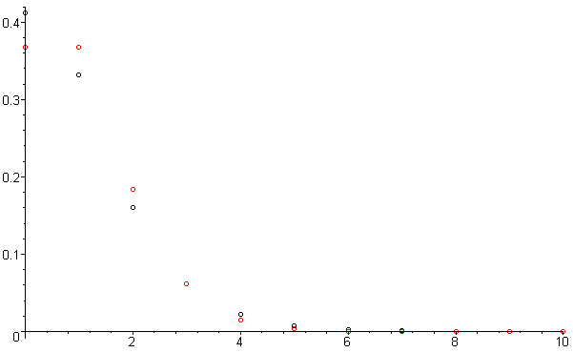
String class
9.2.5.3.2
Proportion of intervals with n hash values
Poisson distribution with λ = 1
Consider the hash of each of the 354985 strings in single.txt to be a random value in 0, 1, 2, 3, …, 2³² – 1
Subdivide the integers into groups of approximately 12099
We expect one hash value per interval
Count the number of these subintervals which contain 0, 1, 2, ... of these hash values
Plotting these proportions and 1/en!, we see they’re very similar

Slide 27
String class
9.2.5.3.3
Problem, Horner’s rule runs in Θ(n)
"A Elbereth Gilthoniel,\n
Silivren penna miriel\n
O menal aglar elenath!\n
Na-chaered palan-diriel\n
O galadhremmin ennorath,\n
Fanuilos, le linnathon\n
nef aear, si nef aearon!"
Suggestions?
J.R.R. Tolkien

Slide 28
String class
9.2.5.3.3
Use characters in locations 2^{k} – 1 for k = 0, 1, 2, ...:
"A_Elbereth Gilthoniel,\n
Silivren_penna miriel\n
O menal aglar elenath!\n
Na-chaered palan-diriel\n
O galadhremmin ennorath,\n
Fanuilos, le linnathon\n
nef aear, si nef aearon!"
J.R.R. Tolkien

Slide 29
String class
9.2.5.3.3
The run time is now Θ(ln(n)) :
unsigned int hash( const string &str ) {
unsigned int hash_value = 0;
for ( int k = 1; k <= str.length(); k *= 2 ) {
hash_value = 12347*hash_value + str[k – 1];
}
return hash_value;
}
Note: this cannot be used if you require a cryptographic hash function or message digest

Slide 30
Arithmetic hash functions
9.2.5.3.3
In general, any member variables that are used to uniquely define an object may be used as coefficients in such a polynomial
The salary hopefully changes over time…
class Person {
string surname;
string *given_names;
unsigned char num_given_names;
unsigned short birth_year;
unsigned char birth_month;
unsigned char birth_day;
unsigned int salary;
// ...
};

Slide 31
Summary
We have seen how a number of objects can be mapped onto a 32-bit integer
We considered
Predetermined hash functions
Auto-incremented variables
Addresses
Hash functions calculated using arithmetic
Next: map a 32-bit integer onto a smaller range 0, 1, ..., M – 1

Slide 32
References
Wikipedia, http://en.wikipedia.org/wiki/Hash_function
[1] Cormen, Leiserson, and Rivest, Introduction to Algorithms, McGraw Hill, 1990.
[2] Weiss, Data Structures and Algorithm Analysis in C++, 3rd Ed., Addison Wesley.
These slides are provided for the ECE 250 Algorithms and Data Structures course. The material in it reflects Douglas W. Harder’s best judgment in light of the information available to him at the time of preparation. Any reliance on these course slides by any party for any other purpose are the responsibility of such parties. Douglas W. Harder accepts no responsibility for damages, if any, suffered by any party as a result of decisions made or actions based on these course slides for any other purpose than that for which it was intended.

